Slide 1



Presented by W&W Studios

Slide 2

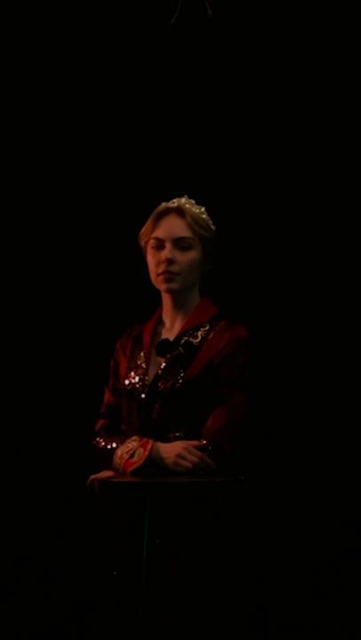






W&W Studios
Reels
Social Promotional video
The contest will launch as Princess Rhaenyra entices fans to create UGC to win tickets for HOTDS2 premiere
#DragonDreamsOnMax
Music City Hall - NYC
houseofthedragonmax
Don the mantle of the story teller, and create what you
you believe should happen in season 2 with
#DragonDreamsOnMax The winner will be invited to
walk the red carpet with the HOTD cast and
have an immersive experience with the Apple Vision Pros
inside of Radio City Music Hall in #NYC for the seasons 2 premiere
sharing content with the brand

Slide 3
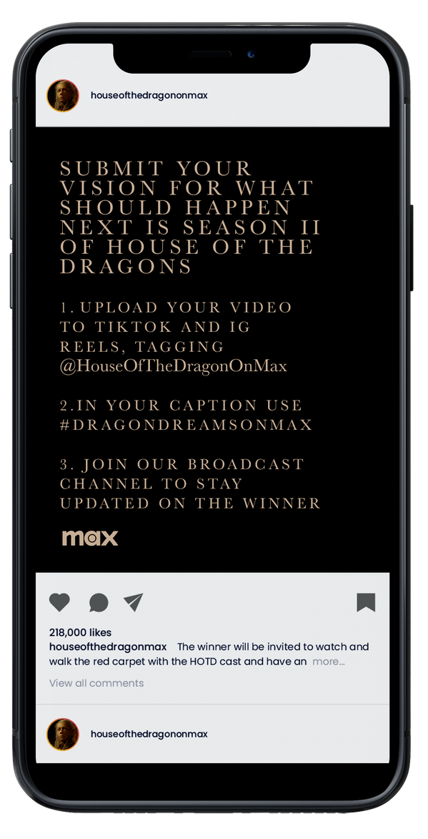
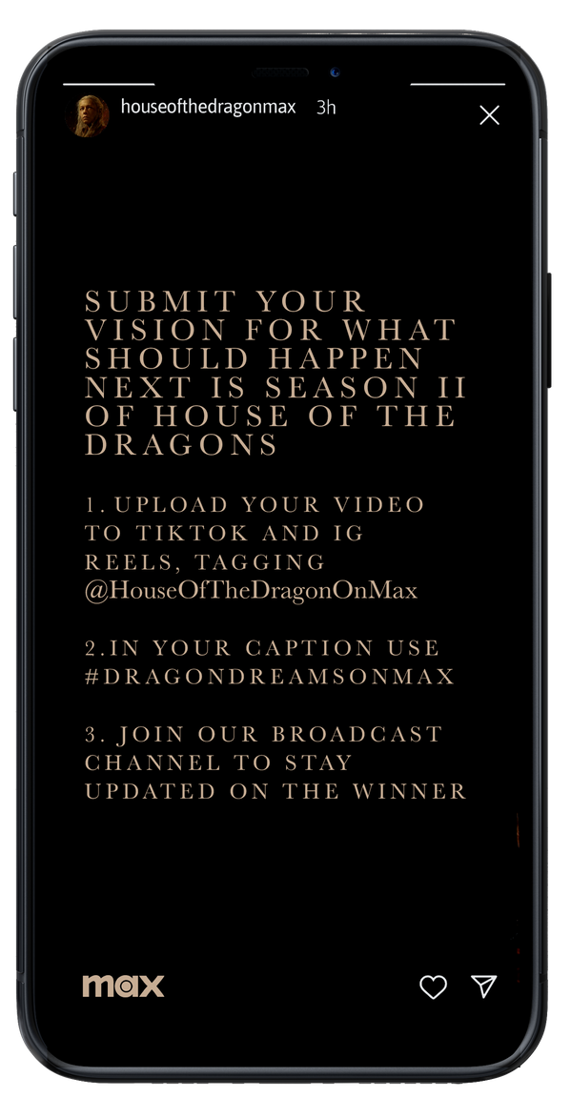
W&W Studios
UGC Contest
Contest Information Social Media Posts

Slide 4
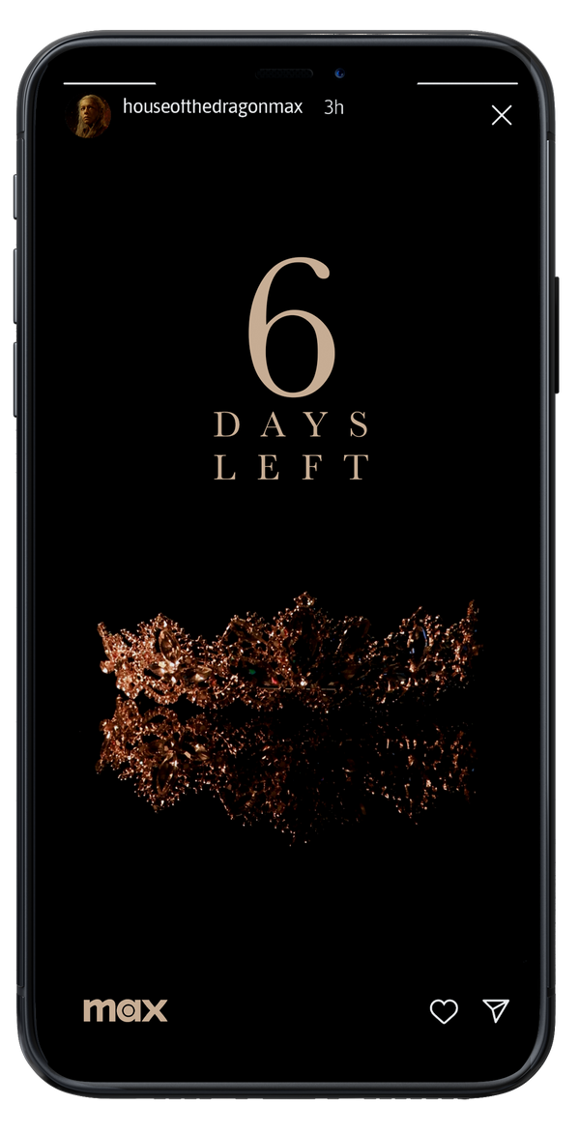
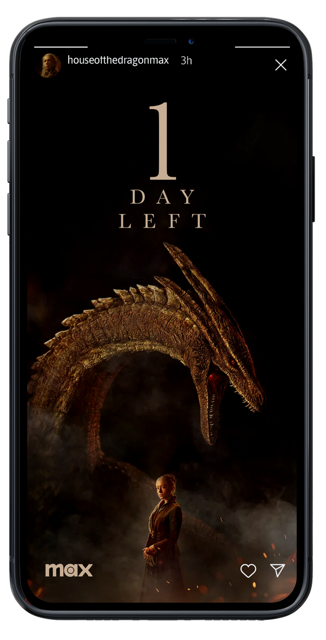
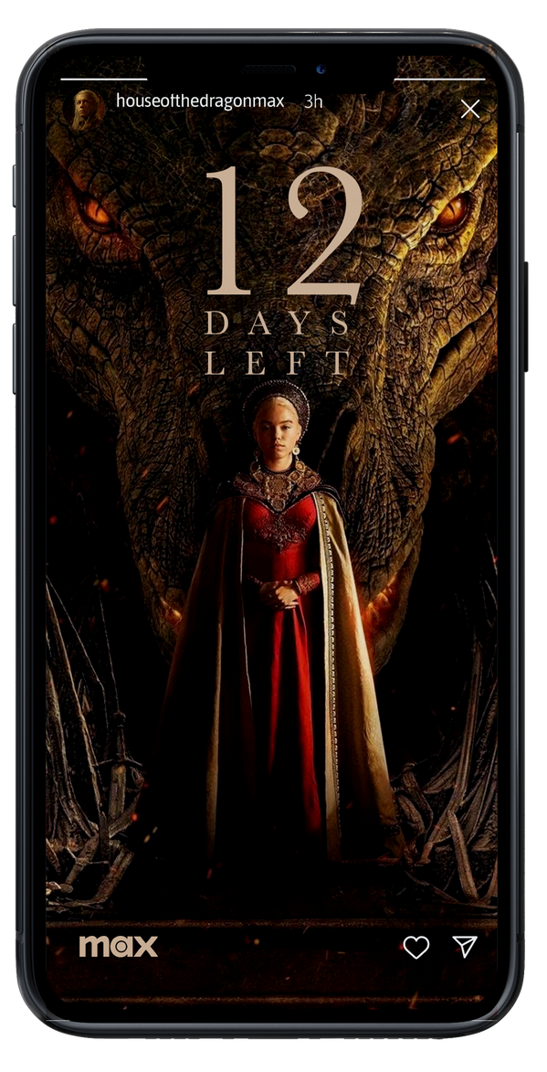
W&W Studios
UGC Contest
Countdown Instagram Stories

Slide 5
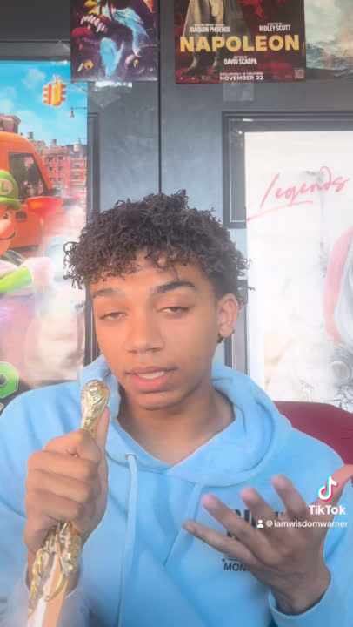
W&W Studios
UGC
Contest
An example of the UGC we expect fans of the show to create as an entry for the contest
subscribe to, actively interact with or share content for a brand

Slide 6
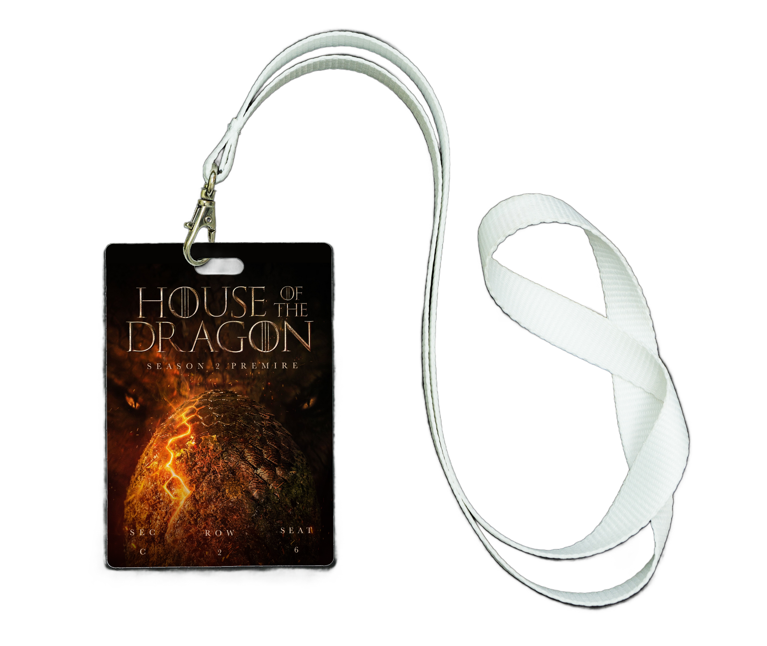
W&W Studios
HOTDS2
premiere
Badge/ Pass for the premiere

Slide 7
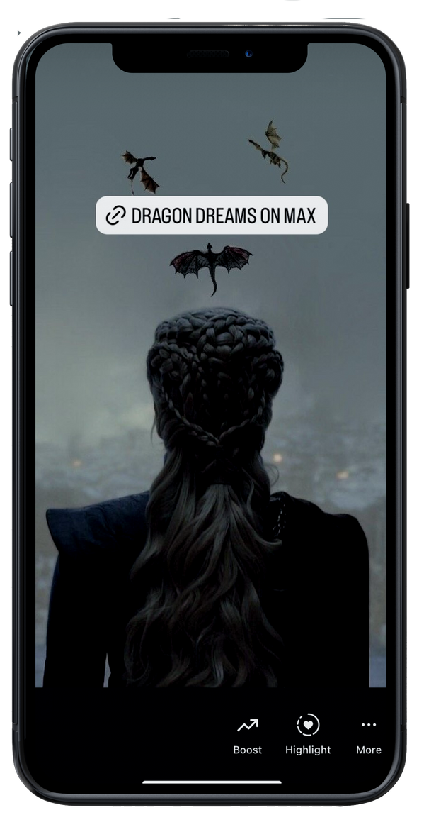
W&W Studios
Broadcast channel
broadcast channel story post

Slide 8
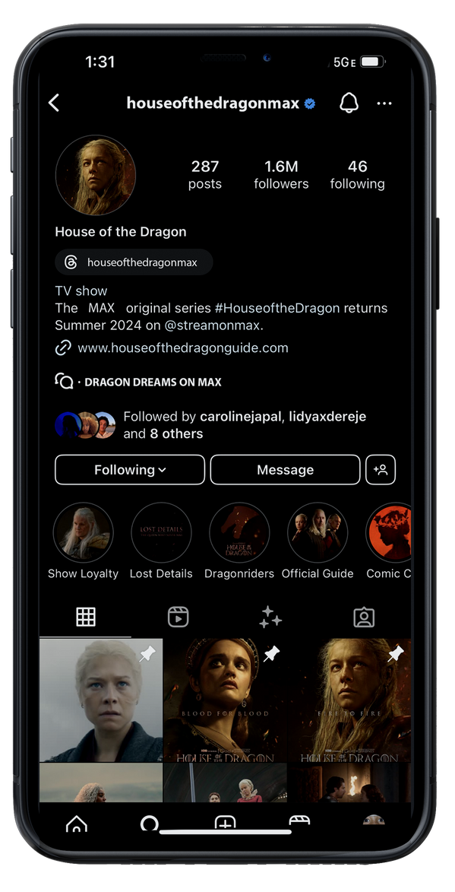
W&W Studios
Broadcast channel
Updated Instagram handle + broadcast channel

Slide 9
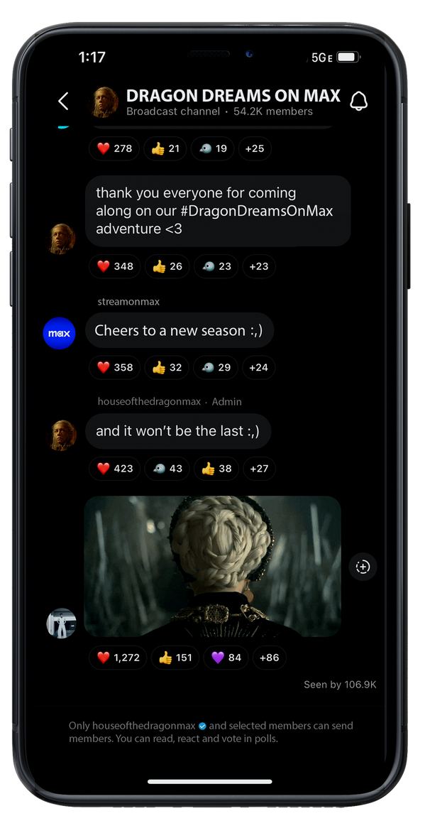
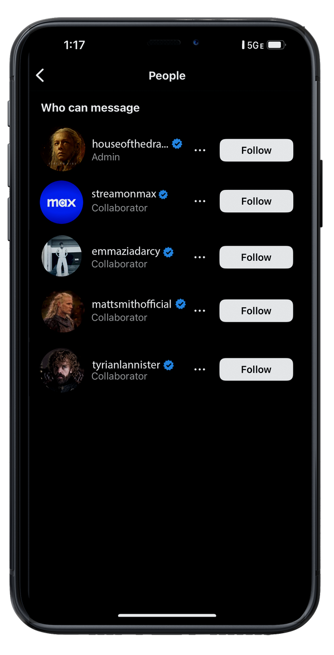
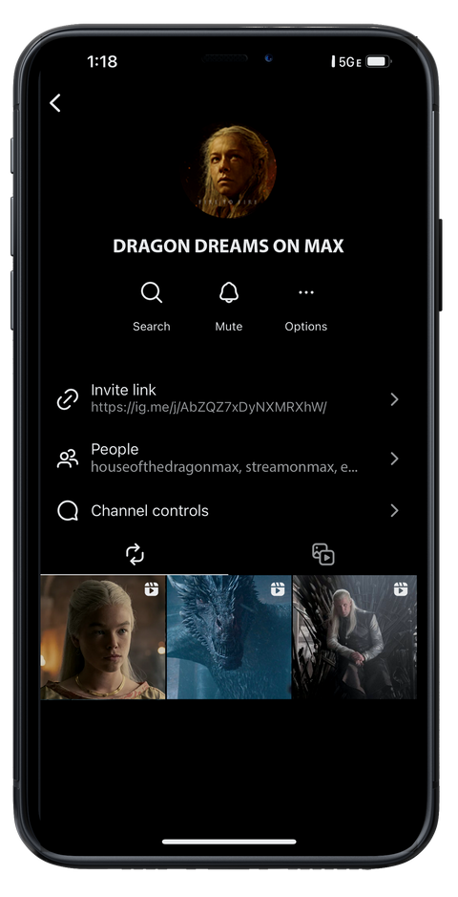
W&W Studios
Broadcast channel
Inside the broadcast channel
+ featured cast
purchase, and/or share information about, a product,

Slide 10
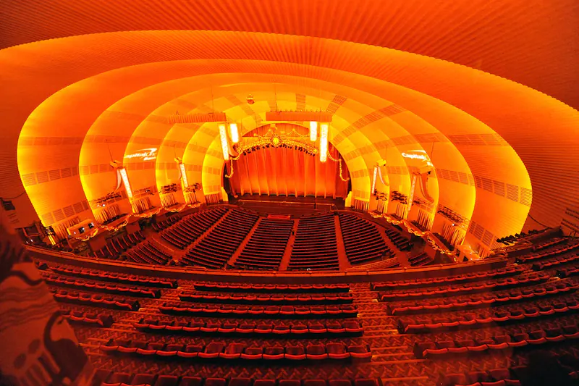
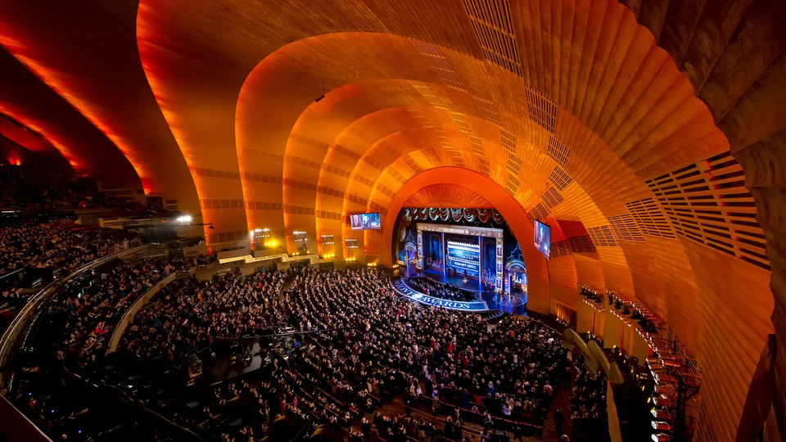
W&W Studios
HOTDS2
premiere
Radio City Music Hall

Slide 11
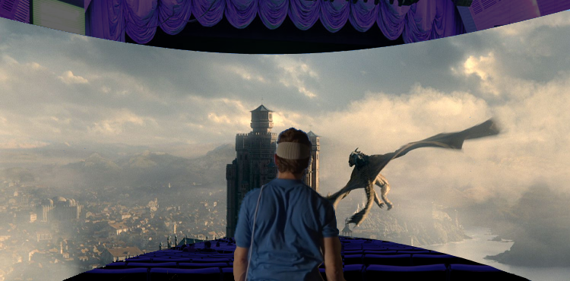

Apple Vision Pros POV
W&W Studios

Slide 12
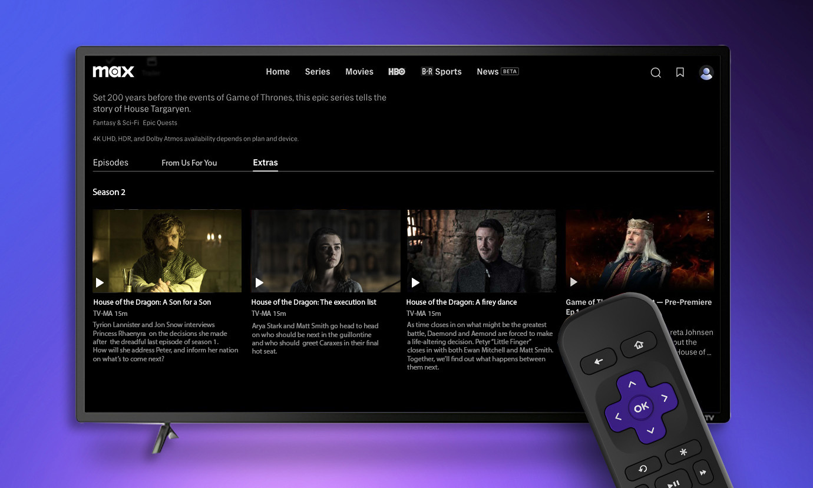
New after show content
Old character vs. New Actor interviews

Slide 13
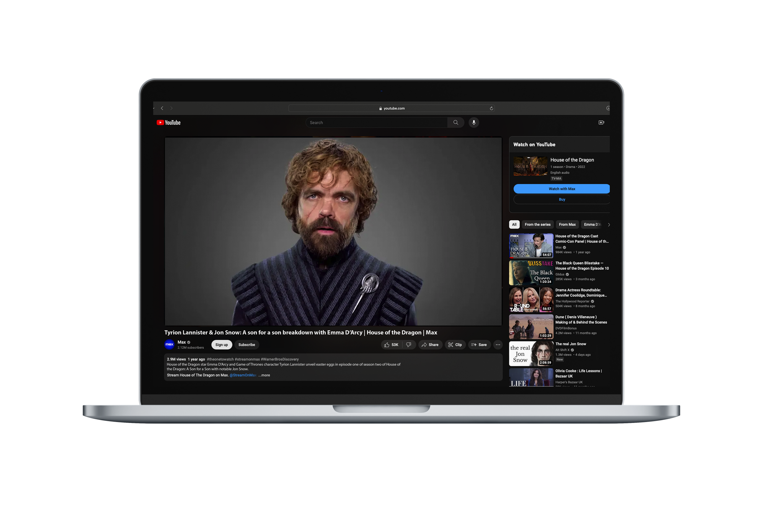
New after show content
Old character vs. New Actor interviews
-MAX on YouTube

Slide 14
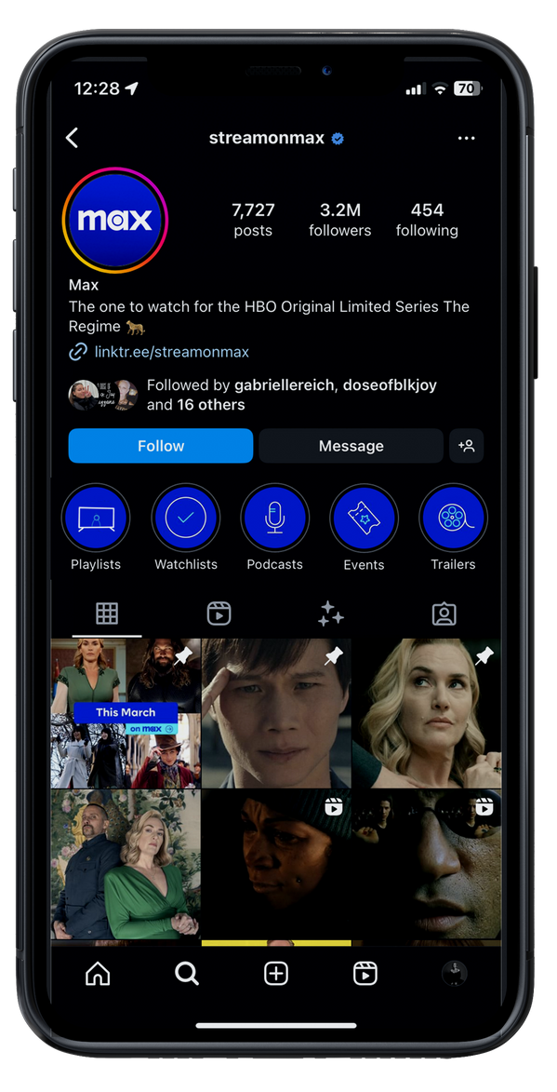
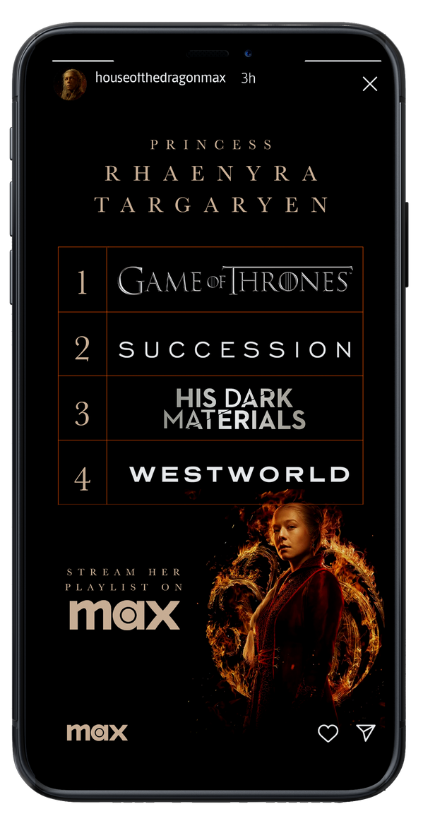
W&W Studios
Character Playlist
Character playlist highlight +
Story post

Slide 15
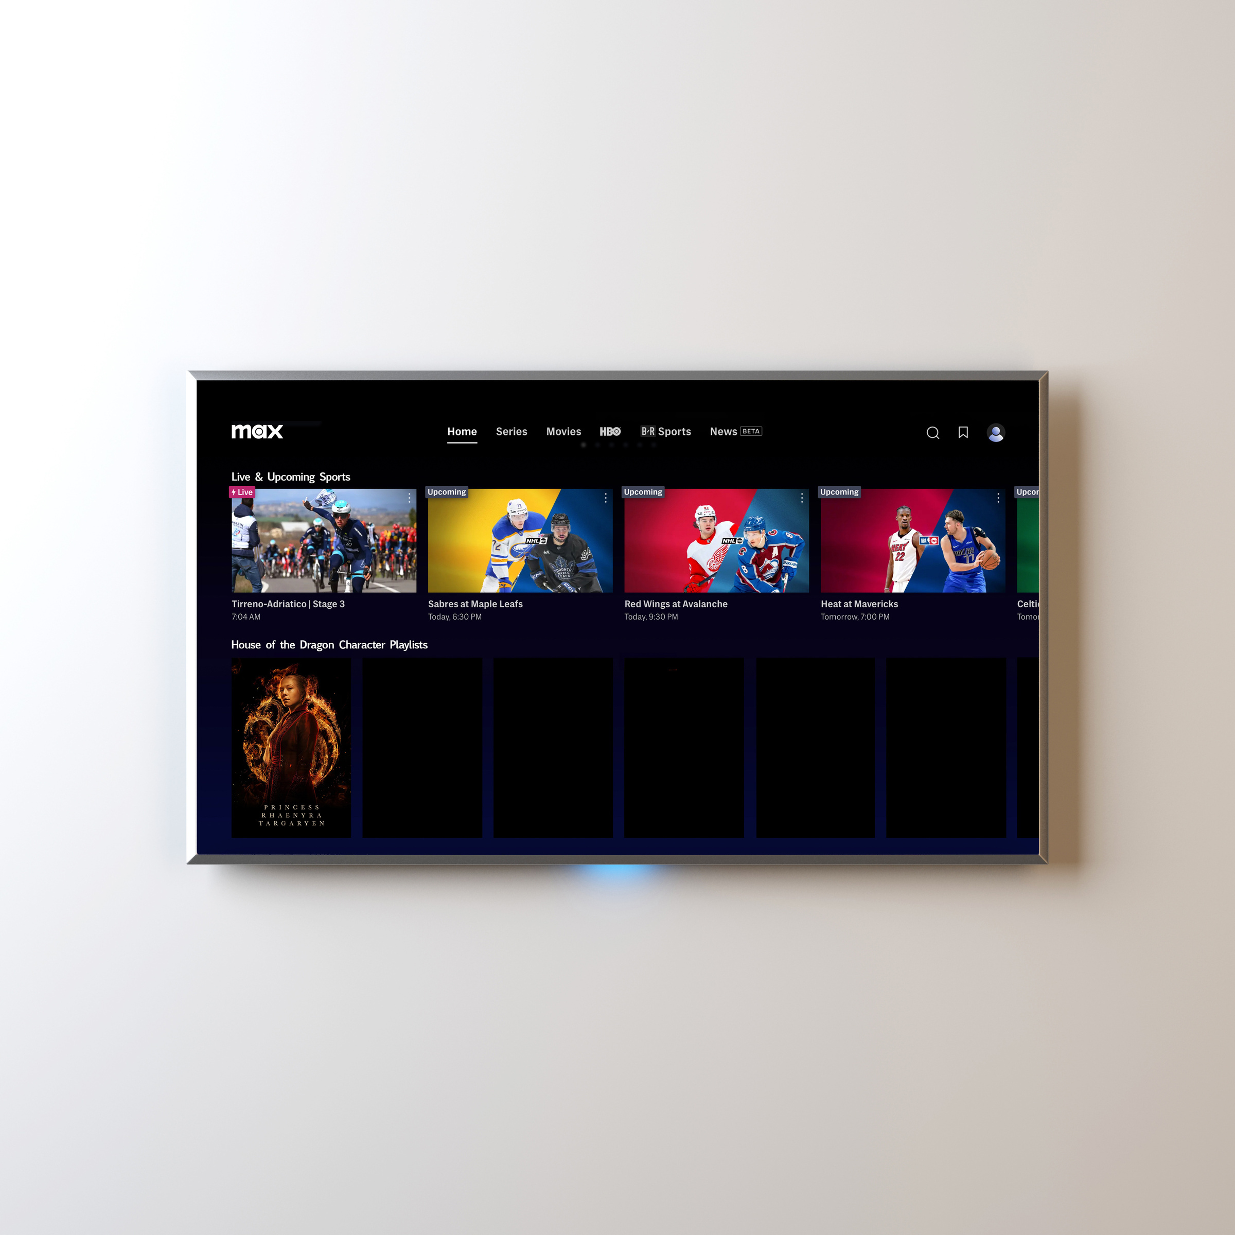
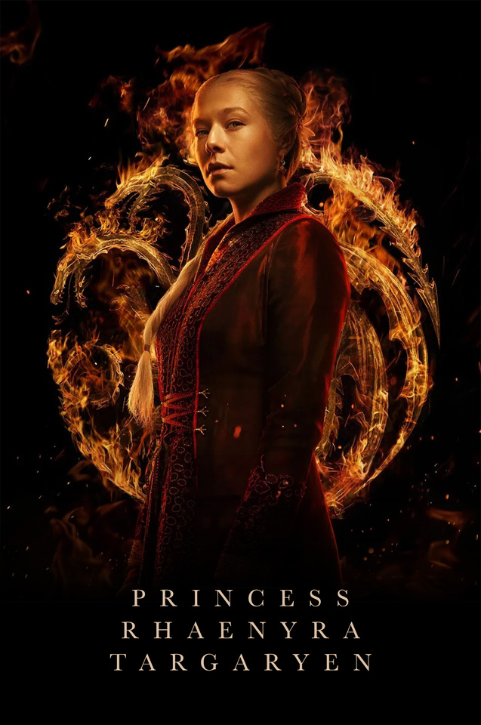

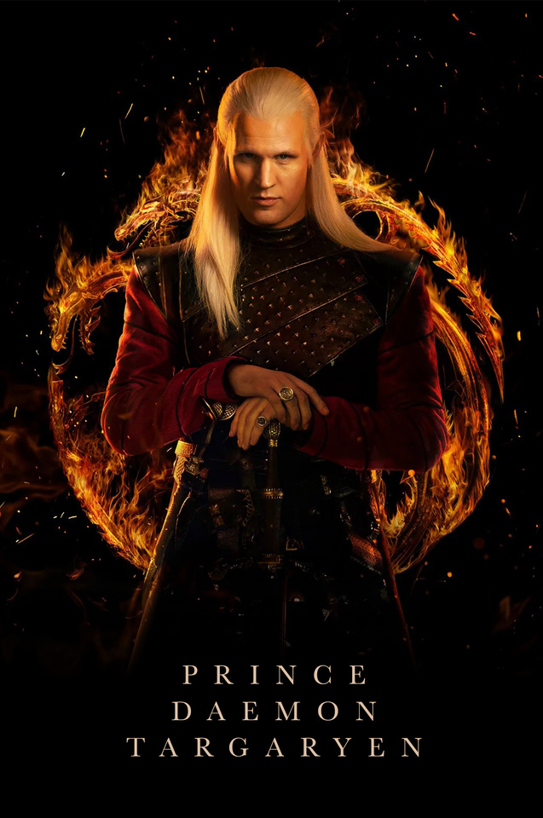
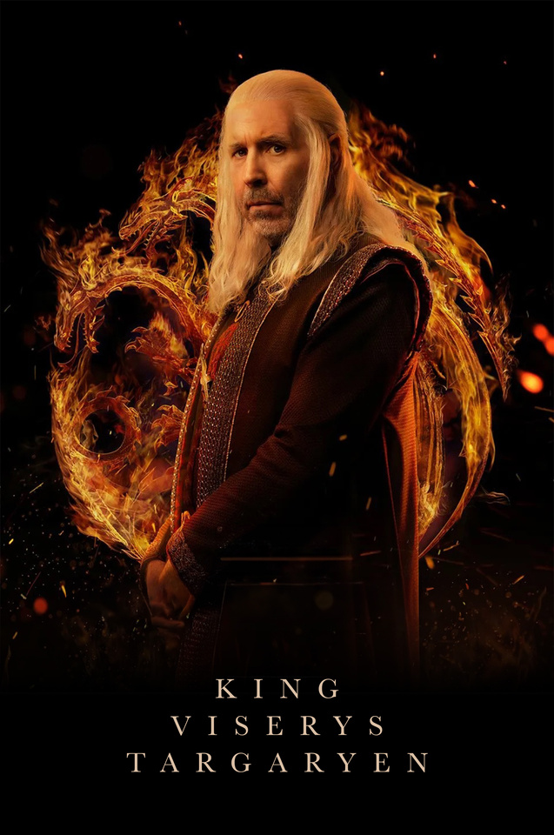

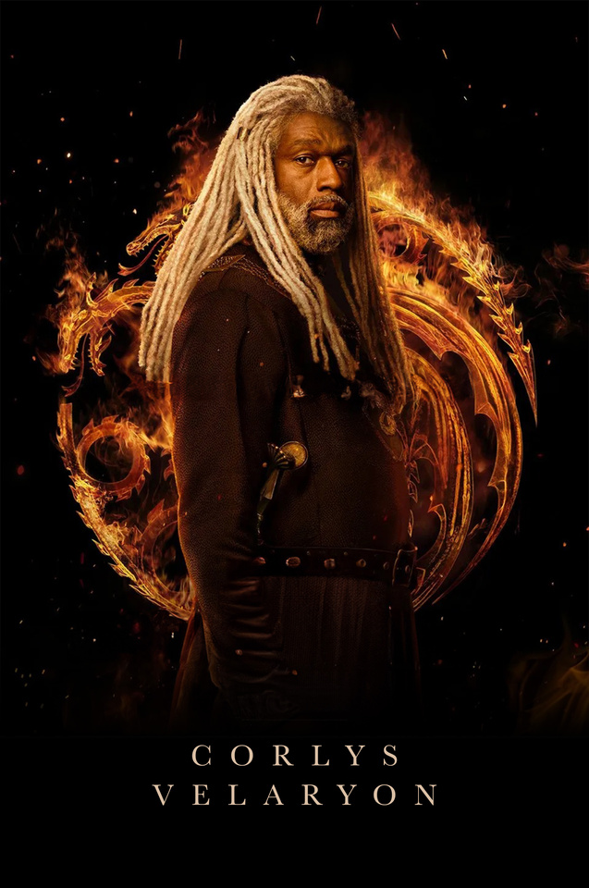
W&W Studios
Character Playlist
“More like this” content curated from the story of your favorite character

Slide 16
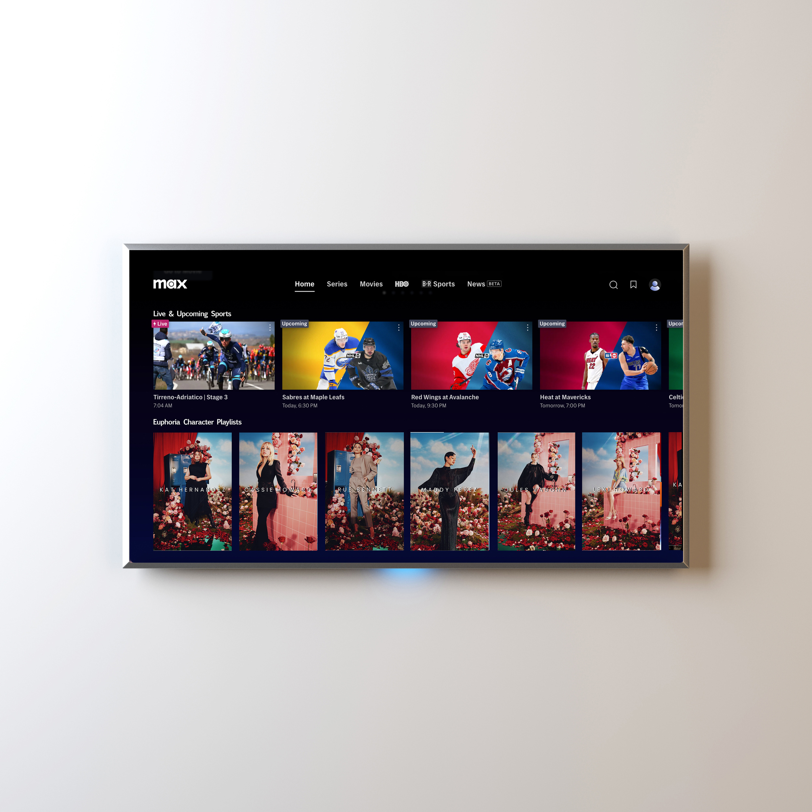
W&W Studios
Character Playlist
We told you it works as
a template ;)

Slide 17
Thank you
presented by W&W Studios

